Slide 1
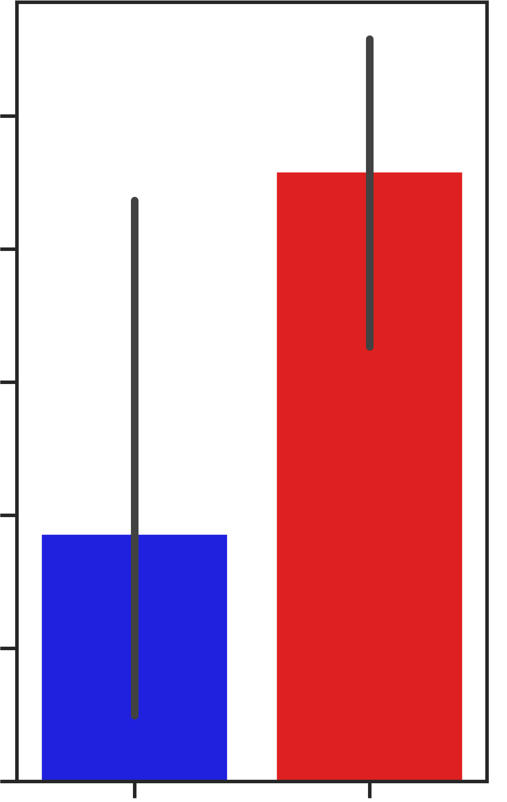
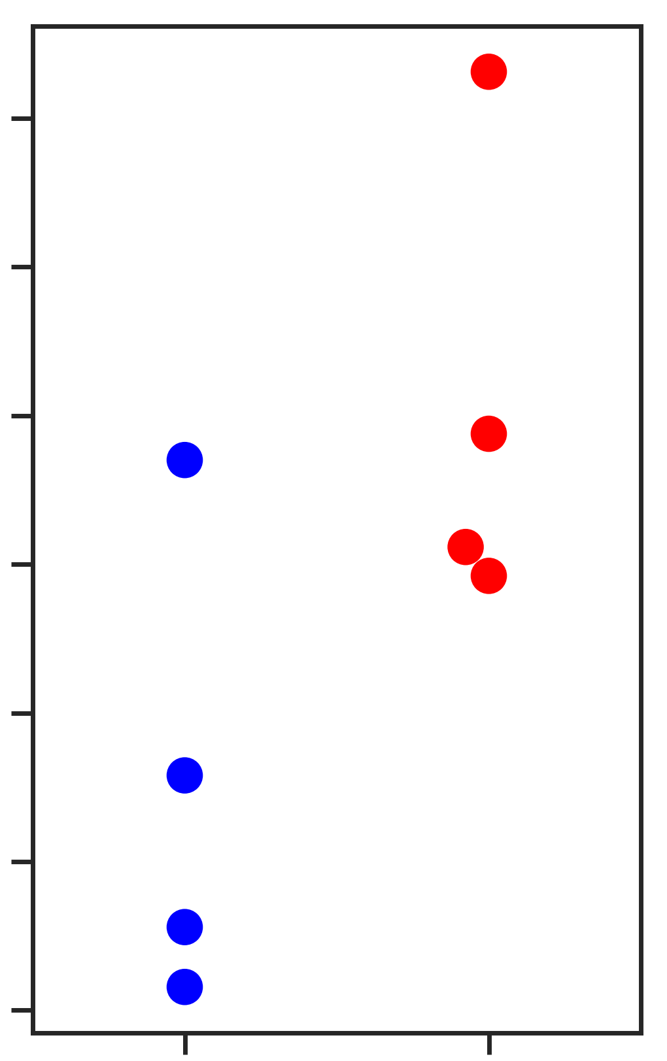
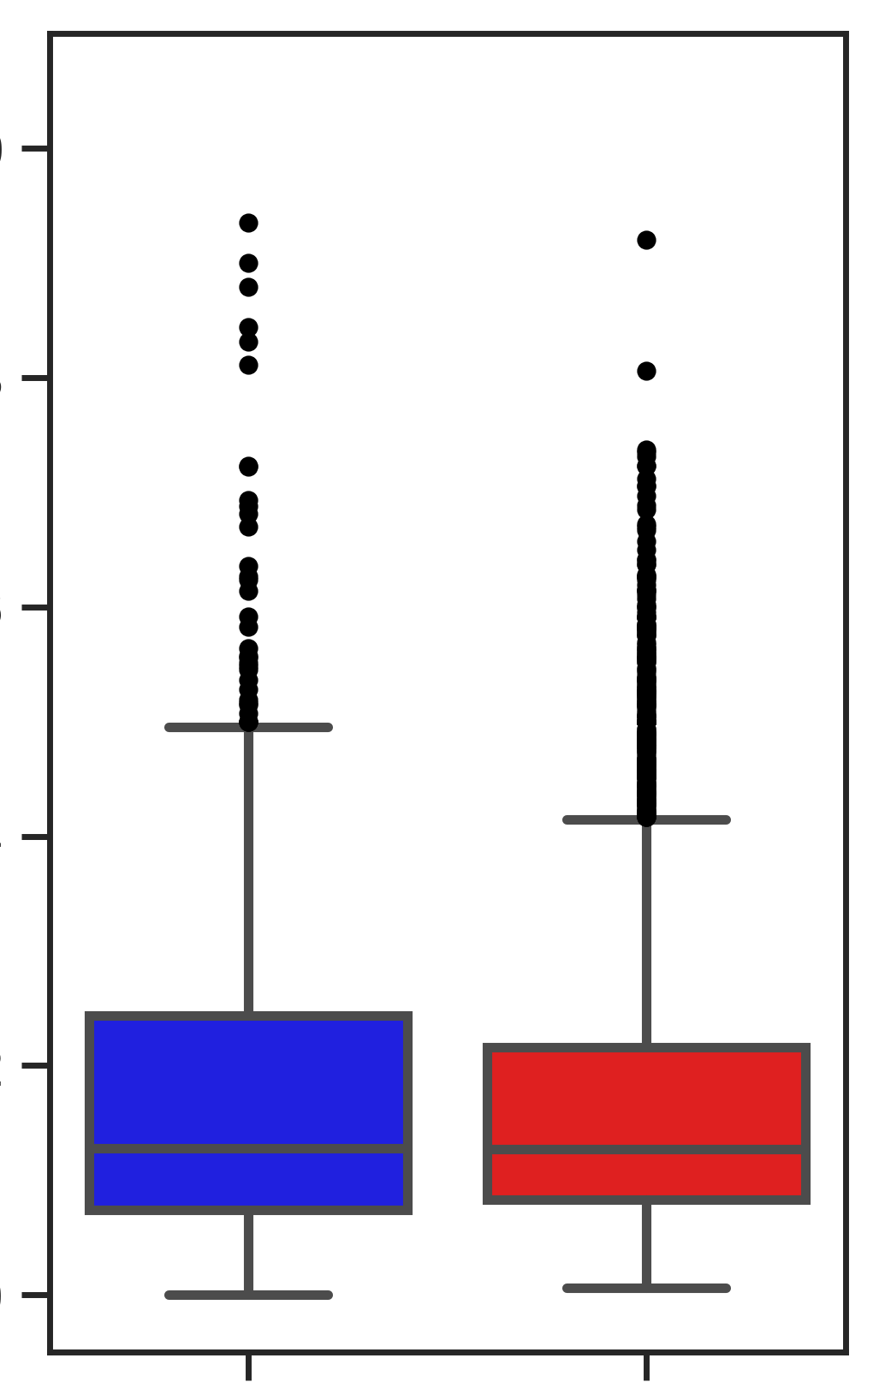
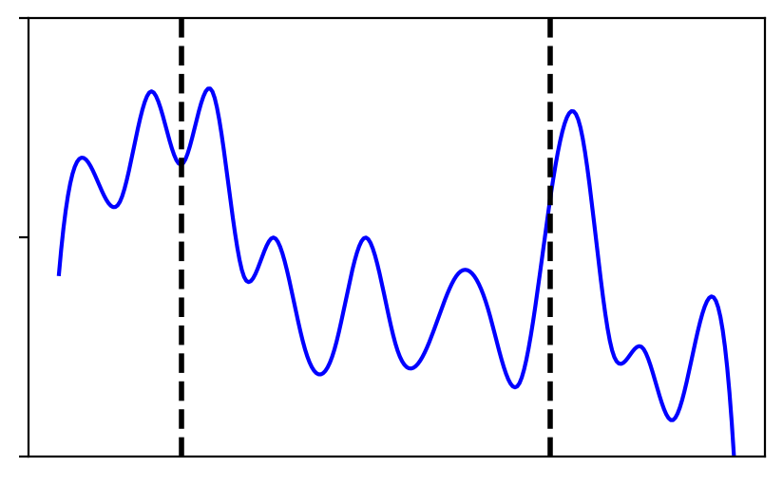
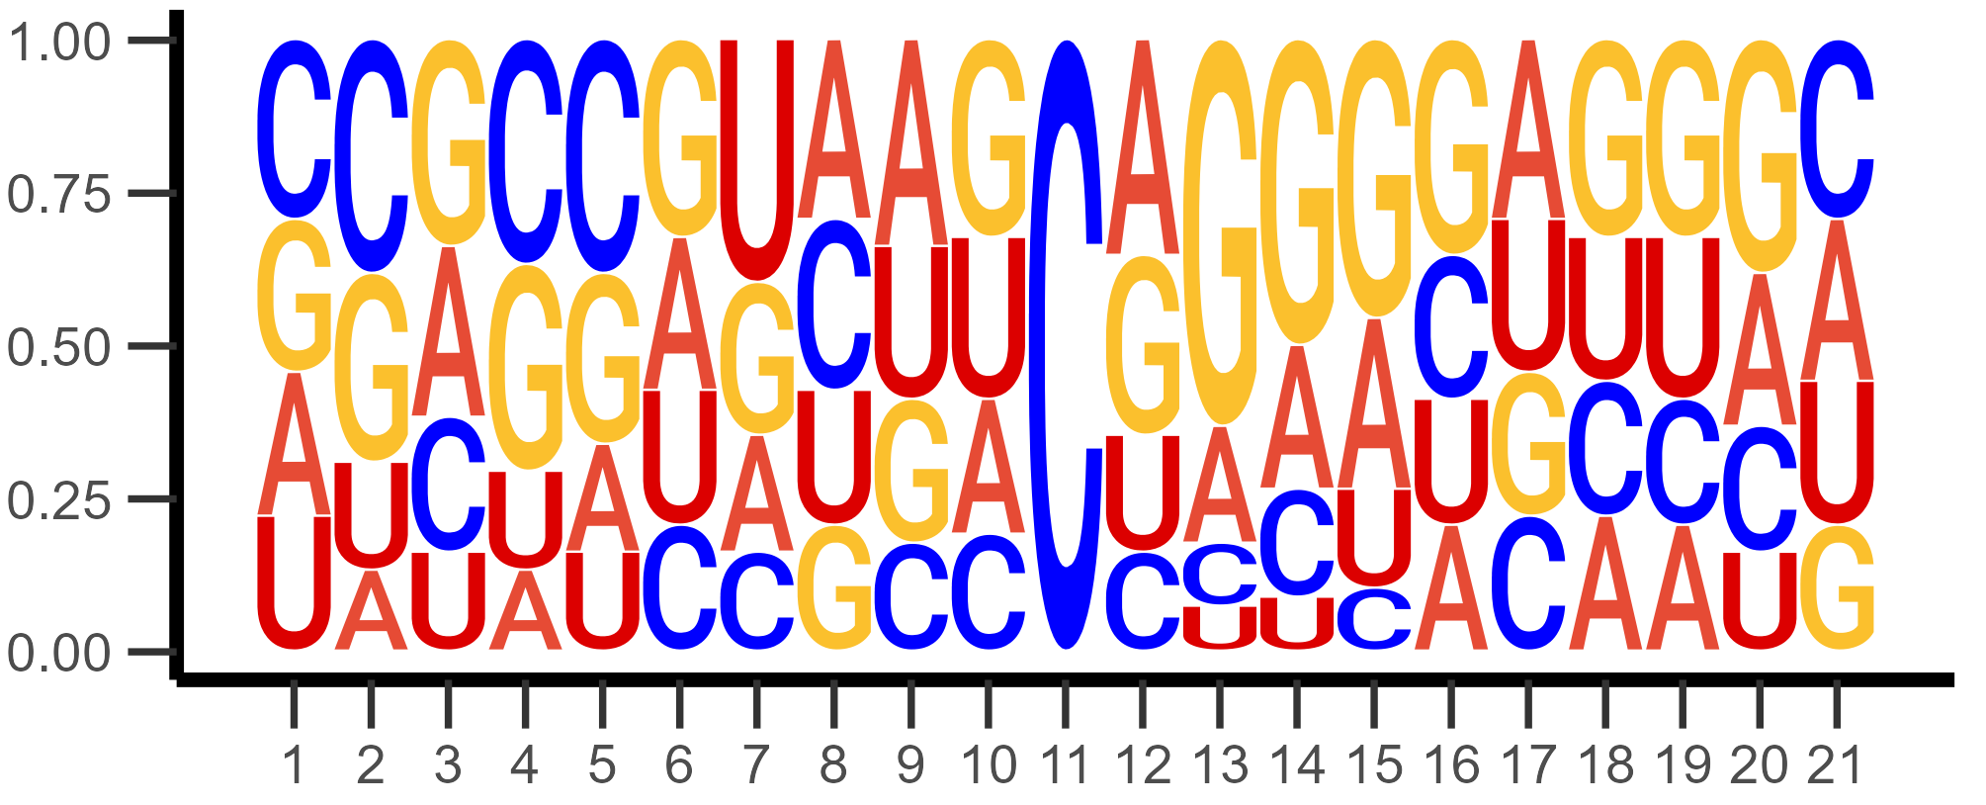
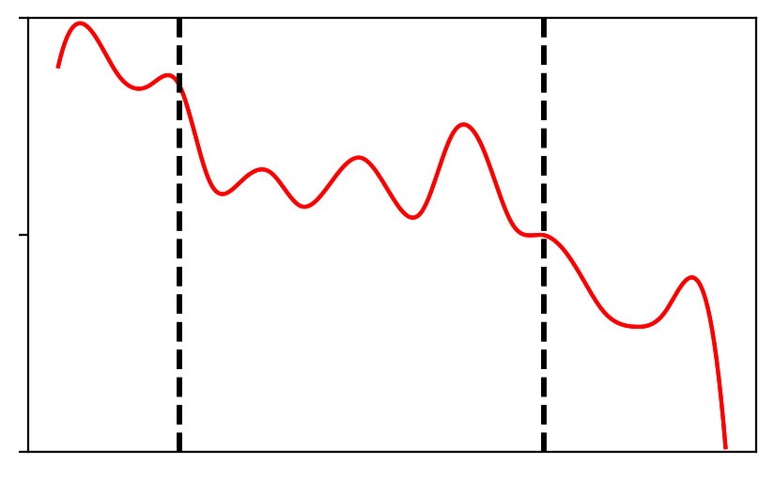
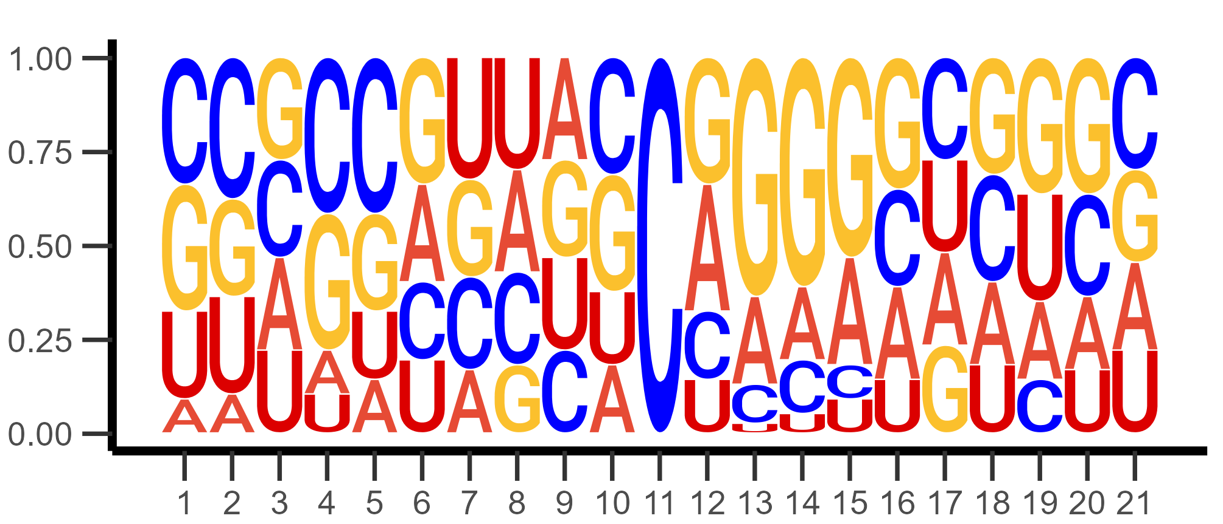
A
B
C
5
4
3
2
1
0
300
250
200
150
100
50
0
Rep 1
Mitochondrial
RNA
Huang
MT-C
Rep 2/3/4
Average Mapped reads
per replicate (x10⁷)
Total p-m⁵C sites per
10⁷ mapped reads
MT-A
31
46
638
MT-B
MT-D
MT RNA
Huang
MT RNA
Huang
D
E
F
Mitochondrial RNA
N=77
Mitochondrial RNA
1.0
0.8
0.6
0.4
0.2
0.0
n.s.
2
1.5
1
0.5
0
Huang
Methylation level
Probability
Huang
N=684
Density (10⁻²)
Position (bp)
MT RNA
Huang
5’UTR
CDS
3’UTR
Figure 6. Characterization of m5C sites among cellular compartments of mouse NSCs
(A) Average mapped read count of bisulfite-converted libraries. Bars represent standard deviation. (B) Methylation calling efficiencies of m5C sites per 107 mapped reads. Mitochondria and Huang replicates are shown in blue and red, respectively. (C) Overlap of high-confidence m5C sites among NSC mitochondria and Huang muscle tissue datasets. (D) Sequence logo surrounding high-confidence m5C sites. (E) Methylation level of high-confidence m5C sites. Significance was tested for using Wilcoxon Rank-Sum. (F) Distribution of m5C sites across a theoretical binned transcript. Bins were calculated using the length of the sites’ longest transcript. 5’UTR and 3’ UTR positions are indicated by dashed lines at bins 5 and 18, respectively.

